Slide 1
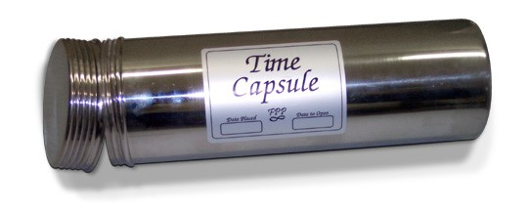
Activity: Review assumptions and expectations
What were your assumptions about this class?
What were your expectations?
<<Instructor>> aggregates responses on the board

Slide 2
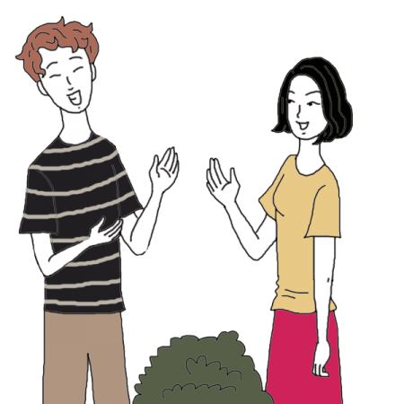
Activity: Discuss in Blackboard
Discuss the assumptions you made about this class
Discuss what you want to learn in Data 601 and have not yet learned
Notes:
https://www.auntyflo.com/dream-dictionary/neighbor

Slide 3

Activity: Write down your expectations
On a piece of paper write down your expectations for the remaining classes
Email me the expectation by the end of class this evening
--> This will help shape my coverage of topics
Activity: think and write

Slide 4
What you want to know more about?
For example,
Basic visualization use in Python
https://jakevdp.github.io/PythonDataScienceHandbook/04.01-simple-line-plots.html
Gallery of what's possible in visualizations
https://matplotlib.org/gallery.html
Fancy visualizations
https://www.makeovermonday.co.uk/makeovers/

Slide 5


Slide 6
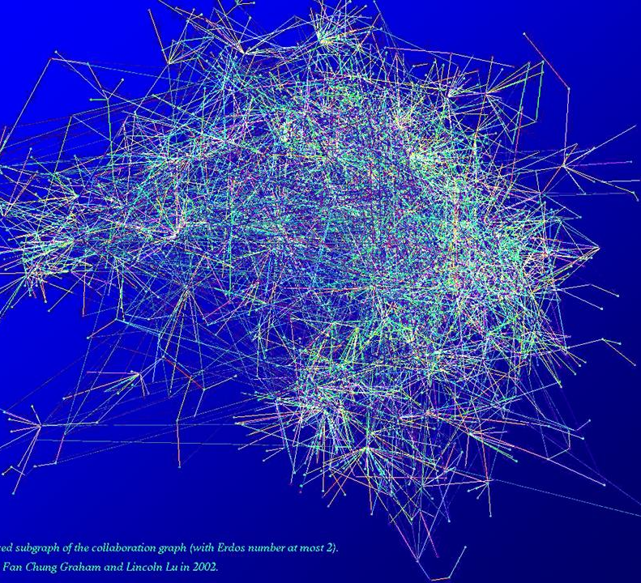
Tables,and Graphs
Source:
https://www.math.ucsd.edu/~fan/complex/
These notes are CC BY 4.0
Notes:
http://www.datasciencecourse.org/notes/graphs/graphs.pdf
To add - https://dgraph.io/
https://news.ycombinator.com/item?id=19168075

Slide 7

Course schedule and outline (scope)
: Overview of Data Science
: Python in Jupyter
: Getting data
: Data cleanup
: Automation; Reports
: Project 1 presentations
: Math
: time series
: Clustering
: Tables and Graphs, Ethics
: Project 2 – reproducibility
: Property Graphs
: Tidy Data
: Scaling up
: Elasticity, Cost/Benefit
: *Final project presentations

Slide 8
By the end of this session,
You should be able to
Explain when to use a list, table, and graph
Describe the advantages of using graph data structures
Create a visualization of a graph
Show how to query information stored in a graph

Slide 9

Introduction to graphs
Addressing points from previous week
Introduction to Graphs
Directed Graphs
Weighted Graphs
Homework
Elevator Pitch

Slide 10

Data Structures covered in Data 601
Scalars (int, float):
4
524.52
-934
Strings:
"ben"
"data 601"
Lists:
["ben", 4, -934, "data 601"]
Tuples:
("ben", "bob")
(3, 4, 9)
Dictionaries:
{"instructor":"ben", "number of cats": 4, (3,4,9): -934, "class":"data 601}
Tables (CSV, Pandas, SQL, Excel) with rows and columns

Slide 11
Table 1 describing relations among entities
Person | Knows | Duration in years
Bob | Anna | 1
Bob | Kate | 4
Bob | James | 2
Anna | Kate | 4
Max | Jim | 1
Kate | Jim | 8
Angela | Anna | 2

Slide 12
Table 2 describing relations among entities
Company | Person | Position | Friend count
Pepsi | Bob | Delivery | 142
Acme | Kate | Sales | 47
Heavy Industry Inc. | Bob | Research | 124
FunTymes | Anna | Coordinator | 634
Roboflex | Max | Manager | 152
HR Support | Kate | Tester | 89
UMBC | Angela | Data Scientist | 252

Slide 13
Graph: nodes and edges
A
H
J
B
G
Node = vertex = an entity
Edge = link = a relation or connection between entities
C
K
F
D
E
Nodes: A, B, C, D, E, F, H, J, K, G, M
M
Edges: (A,B), (C,G), (C,E), (D,H), (E,K), (F,M), (H,G), (J,K), (G,K)
Caveat: this graph is unrelated to the tables in the previous slide

Slide 14
Conventional distinction
Networks are the systems of interrelated objects (in the real world)
Graphs are the mathematical model for representing networks
source

Slide 15
Relation between graph and adjacency matrix
A
H
 | A | B | C | D | E | F | G | H | J | K | M
A | 0 | 1 | 0 | 0 | 0 | 0 | 0 | 0 | 0 | 0 | 0
B | 1 | 0 | 0 | 0 | 0 | 0 | 0 | 0 | 0 | 0 | 0
C | 0 | 0 | 0 | 0 | 1 | 0 | 1 | 0 | 0 | 0 | 0
D | 0 | 0 | 0 | 0 | 0 | 0 | 0 | 1 | 0 | 0 | 0
E | 0 | 0 | 1 | 0 | 0 | 0 | 0 | 0 | 0 | 1 | 0
F | 0 | 0 | 0 | 0 | 0 | 0 | 0 | 0 | 0 | 0 | 1
G | 0 | 0 | 1 | 0 | 0 | 0 | 0 | 1 | 0 | 1 | 0
H | 0 | 0 | 0 | 1 | 0 | 0 | 1 | 0 | 0 | 0 | 0
J | 0 | 0 | 0 | 0 | 0 | 0 | 0 | 0 | 0 | 1 | 0
K | 0 | 0 | 0 | 0 | 1 | 0 | 1 | 0 | 1 | 0 | 0
M | 0 | 0 | 0 | 0 | 0 | 1 | 0 | 0 | 0 | 0 | 0
J
B
G
C
K
F
0 = no connection
1 = edge exists
D
E
M
Nodes: A, B, C, D, E, F, H, J, K, G, M
Edges: (A,B), (C,G), (C,E), (D,H), (E,K), (F,M), (H,G), (J,K), (G,K)
Number of entries with "1" is double the number of edges

Slide 16
Matrix for Undirected graph has diagonal symmetry
A
H
 | A | B | C | D | E | F | G | H | J | K | M
A | 0 | 1 | 0 | 0 | 0 | 0 | 0 | 0 | 0 | 0 | 0
B | 1 | 0 | 0 | 0 | 0 | 0 | 0 | 0 | 0 | 0 | 0
C | 0 | 0 | 0 | 0 | 1 | 0 | 1 | 0 | 0 | 0 | 0
D | 0 | 0 | 0 | 0 | 0 | 0 | 0 | 1 | 0 | 0 | 0
E | 0 | 0 | 1 | 0 | 0 | 0 | 0 | 0 | 0 | 1 | 0
F | 0 | 0 | 0 | 0 | 0 | 0 | 0 | 0 | 0 | 0 | 1
G | 0 | 0 | 1 | 0 | 0 | 0 | 0 | 1 | 0 | 1 | 0
H | 0 | 0 | 0 | 1 | 0 | 0 | 1 | 0 | 0 | 0 | 0
J | 0 | 0 | 0 | 0 | 0 | 0 | 0 | 0 | 0 | 1 | 0
K | 0 | 0 | 0 | 0 | 1 | 0 | 1 | 0 | 1 | 0 | 0
M | 0 | 0 | 0 | 0 | 0 | 1 | 0 | 0 | 0 | 0 | 0
J
B
G
C
K
F
D
E
M
Nodes: A, B, C, D, E, F, H, J, K, G, M
Edges: (A,B), (C,G), (C,E), (D,H), (E,K), (F,M), (H,G), (J,K), (G,K)
Number of entries with "1" is double the number of edges

Slide 17
Difference between graph, plot, chart, figure?

Slide 18
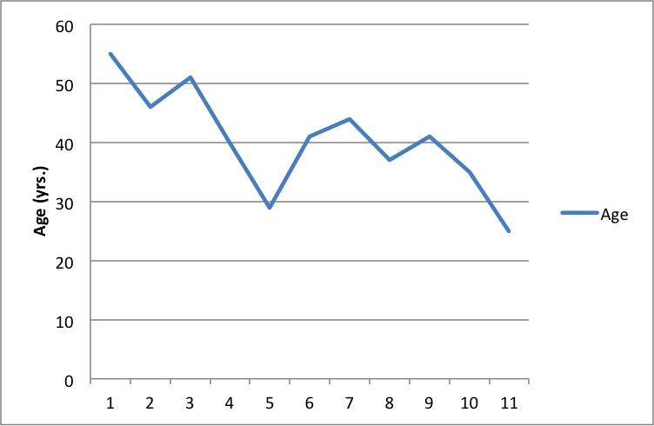

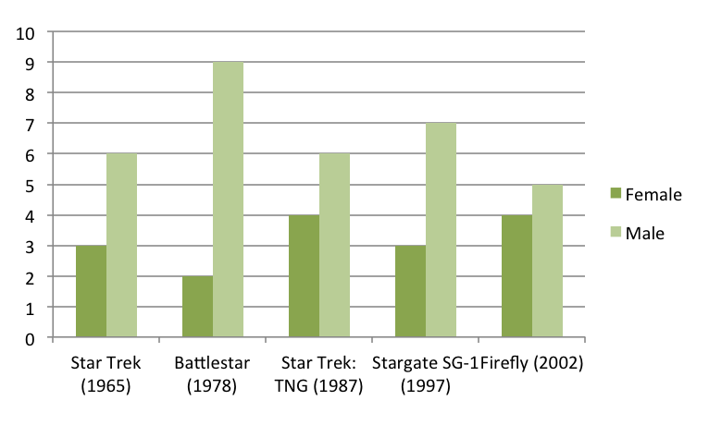
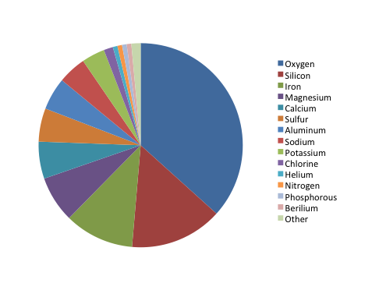
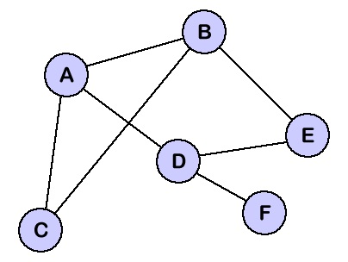
Jargon: Graph versus Chart versus Plot versus Figure
All are referred to as {graph, chart, plot, figure}

Slide 19
Why add graphs if tables are equivalent?
A
H
 | A | B | C | D | E | F | G | H | J | K | M
A | 0 | 1 | 0 | 0 | 0 | 0 | 0 | 0 | 0 | 0 | 0
B | 1 | 0 | 0 | 0 | 0 | 0 | 0 | 0 | 0 | 0 | 0
C | 0 | 0 | 0 | 0 | 1 | 0 | 1 | 0 | 0 | 0 | 0
D | 0 | 0 | 0 | 0 | 0 | 0 | 0 | 1 | 0 | 0 | 0
E | 0 | 0 | 1 | 0 | 0 | 0 | 0 | 0 | 0 | 1 | 0
F | 0 | 0 | 0 | 0 | 0 | 0 | 0 | 0 | 0 | 0 | 1
G | 0 | 0 | 1 | 0 | 0 | 0 | 0 | 1 | 0 | 1 | 0
H | 0 | 0 | 0 | 1 | 0 | 0 | 1 | 0 | 0 | 0 | 0
J | 0 | 0 | 0 | 0 | 0 | 0 | 0 | 0 | 0 | 1 | 0
K | 0 | 0 | 0 | 0 | 1 | 0 | 1 | 0 | 1 | 0 | 0
M | 0 | 0 | 0 | 0 | 0 | 1 | 0 | 0 | 0 | 0 | 0
J
B
G
C
K
F
D
E
M

Slide 20
Use graphs when focused on relations among entities
Benefits:
Different way of thinking about the problem
Useful for questions where relations are complex
Defining all values (ie in a table) is not required
Potentially more efficient representation when compared to a table
Representation is intuititive
Makes pretty pictures

Slide 21
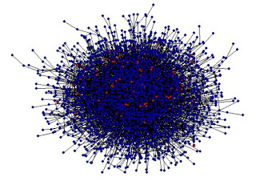
Costs of using graph to represent data
Requires different algorithms (compared to table-based data)
Learning
Visual Rendering of large graphs is slow
Visual rendering of large graphs is useless: "hairball"

Slide 22
Applications of graphs

Slide 23
Use case for graphs: Fraud detection for banking and for credit card transactions
Known Fraudster
customer
Lives with
vendor
Buys from
Buys from
Buys from
Buys from
vendor
Based on activities of known bad actor, do other (related) people have similar behavior?
vendor
vendor
vendor
Notes:
https://towardsdatascience.com/getting-started-with-graph-analysis-in-python-with-pandas-and-networkx-5e2d2f82f18e

Slide 24
Use case for graphs: Fraud detection for banking and for credit card transactions
Known Fraudster
customer
vendor
Buys from
Buys from
Buys from
Buys from
customer
Are certain behaviors or patterns associated with bad actors? (Outlier detection)
vendor
vendor
vendor
Notes:
https://towardsdatascience.com/getting-started-with-graph-analysis-in-python-with-pandas-and-networkx-5e2d2f82f18e

Slide 25
Use case for graphs: Natural Language Processing
https://medium.com/@aneesha/beyond-bag-of-words-using-pytextrank-to-find-phrases-and-summarize-text-f736fa3773c5
Words are added to the graph as nodes
An edge is added between words that co-occur within N words of each other
This is then used as a feature for machine learning algorithms
Notes:
https://ocw.mit.edu/courses/electrical-engineering-and-computer-science/6-864-advanced-natural-language-processing-fall-2005/lecture-notes/lec18.pdf
https://en.wikipedia.org/wiki/Text_graph
https://medium.com/@aneesha/beyond-bag-of-words-using-pytextrank-to-find-phrases-and-summarize-text-f736fa3773c5

Slide 26
Social Network Analysis applied in advertising
Companies sell graph database of consumers
https://www.faraday.io/

Slide 27
Social Network Analysis applied in advertising
How the graph gets used by advertisers:
https://blog.liveintent.com/identity-graphs-power-the-next-era-of-marketing/
https://www.signal.co/blog/6-things-about-id-graphs/
https://www.zdnet.com/article/microsoft-touts-linkedin-graph-api-and-ai-foundations-of-its-new-bing-ad-service/

Slide 28
Graph visualization

Slide 29
Relations and Layout are unrelated
A
H
J
F
D
B
G
J
C
K
M
F
A
H
E
B
D
M
K
G
E
Positions of nodes is irrelevant
Length of edges is irrelevant
C

Slide 30
Static Visualization of Graphs
Graphviz is a stand-alone graph rendering tool with a domain specific language, "dot," for describing graphs
http://www.graphviz.org/
There's a Python module:
https://pypi.org/project/graphviz/
Demo: graphviz_for_static_graph_visualization.ipynb

Slide 31
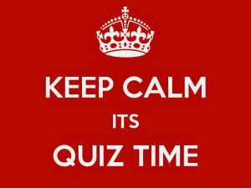

Slide 32
Objective of this quiz is to evaluate your understanding of how well you understand relation between graph and adjacency matrix
In addition to this one, there are four more of these quizzes coming
These quizzes are not graded; they are not a factor in your course grade

Slide 33
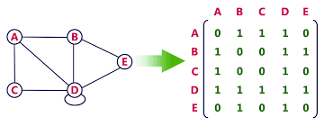

Vote for the missing entry in the table

Slide 34
Answer for the missing entry in the table

Slide 35
Explanation for the missing entry in the table
Use symmetry of adjacency matrix to identify missing value

Slide 36
Activity: Partner check-in
Count of by 1,2,3,4,5,6,7,1,2,3,4,5,6,7
Find your partner who has the same number

Slide 37
Activity: Partner check-in
Count of by 1,2,3,4,5,6,7,1,2,3,4,5,6,7
Find your partner who has the same number
Summarize the content covered in this session so far

Slide 38
Another Python package for graphs: networkx
Demo: networkx.ipynb
https://en.wikipedia.org/wiki/Six_Degrees_of_Kevin_Bacon
https://en.wikipedia.org/wiki/Shortest_path_problem#Undirected_graph
https://en.wikipedia.org/wiki/Floyd%E2%80%93Warshall_algorithm
https://networkx.github.io/documentation/stable/reference/algorithms/shortest_paths.html

Slide 39
Directed Graphs
Addressing points from week 11
Introduction to Graphs
Graph visualization
Directed Graphs
Weighted Graphs
Homework
Elevator pitch

Slide 40
Directed Graph: edges with direction
A
H
J
B
Edges can be
Directionless
single direction
both directions
What is "correct" depends on what the graph is describing
G
C
K
F
D
E
M
Notes:
https://stackoverflow.com/questions/20133479/how-to-draw-directed-graphs-using-networkx-in-python

Slide 41
Example application of directed graph
Folders and files
Demo: Pycallgraph.ipynb
Demo: files_and_folders.ipynb

Slide 42
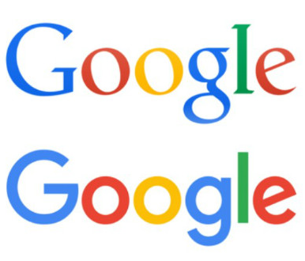
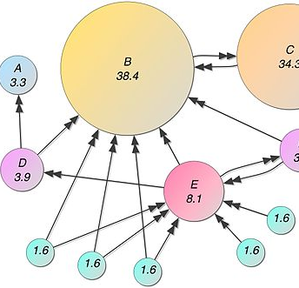
Use case for a graph of web links
https://en.wikipedia.org/wiki/PageRank
Websites to make a graph of
https://scrapethissite.com/
http://toscrape.com/
You have the tools – wget, curl, scrapy
Notes:
Need more than just a link here

Slide 43
Relation between table and directed graph
Destination node (to)
A
H
 | A | B | C | D | E | F | G | H | J | K | M
A | 0 | 1 | 0 | 0 | 0 | 0 | 0 | 0 | 0 | 0 | 0
B | 0 | 0 | 0 | 0 | 0 | 0 | 0 | 0 | 0 | 0 | 0
C | 0 | 0 | 0 | 0 | 1 | 0 | 0 | 0 | 0 | 0 | 0
D | 0 | 0 | 0 | 0 | 0 | 0 | 0 | 0 | 0 | 0 | 0
E | 0 | 0 | 0 | 0 | 0 | 0 | 0 | 0 | 0 | 1 | 0
F | 0 | 0 | 0 | 0 | 0 | 0 | 0 | 0 | 0 | 0 | 1
G | 0 | 0 | 1 | 0 | 0 | 0 | 0 | 1 | 0 | 0 | 0
H | 0 | 0 | 0 | 1 | 0 | 0 | 0 | 0 | 0 | 0 | 0
J | 0 | 0 | 0 | 0 | 0 | 0 | 0 | 0 | 0 | 1 | 0
K | 0 | 0 | 0 | 0 | 0 | 0 | 1 | 0 | 1 | 0 | 0
M | 0 | 0 | 0 | 0 | 0 | 0 | 0 | 0 | 0 | 0 | 0
J
B
G
C
K
F
Source
Node
(From)
D
E
M
Sanity check: Number of entries with "1" should equal number of arrow heads

Slide 44
Vote for the missing entry in the adjacency matrix

Slide 45
Objective of this quiz is to evaluate your understanding of how well you understand relation between directed graph and adjacency matrix
Quizzes 2 and 3 of 4

Slide 46
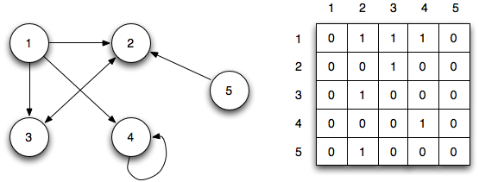
Vote for the missing entry in the table
Source: http://faculty.ycp.edu/~dbabcock/PastCourses/cs360/lectures/lecture15.html
Notes:
http://faculty.ycp.edu/~dbabcock/PastCourses/cs360/lectures/lecture15.html

Slide 47
Answer for the missing entry in the table
Source: http://faculty.ycp.edu/~dbabcock/PastCourses/cs360/lectures/lecture15.html
Notes:
http://faculty.ycp.edu/~dbabcock/PastCourses/cs360/lectures/lecture15.html

Slide 48
Explanation for the missing entry in the table
Directed graphs are not symmetric
1 --> 2 and 1 --> 3 and 1 --> 4; first row captures that
Nothing goes to 1
To
From
Source: http://faculty.ycp.edu/~dbabcock/PastCourses/cs360/lectures/lecture15.html
Notes:
http://faculty.ycp.edu/~dbabcock/PastCourses/cs360/lectures/lecture15.html

Slide 49
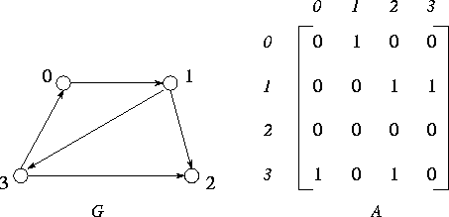
Vote for the missing entry in the table
Notes:
https://www.mcs.anl.gov/~itf/dbpp/text/node35.html

Slide 50
To
Answer for missing entry in the table
Directed graphs are not symmetric
1 --> 2 and 3 --> 2; column "2" captures that
From 3 to 0 means the lower-left value is 1
From
Notes:
https://www.mcs.anl.gov/~itf/dbpp/text/node35.html

Slide 51
Weighted Graphs
Addressing points from previous week
Introduction to Graphs
Directed Graphs
Weighted Graphs
Homework
Elevator Pitch

Slide 52
Use case for graphs: Logistics
Routing of
Flights (American, Delta, Southwest, United, Spirit)
Delivery trucks (Amazon, USPS, FedEx, UPS, DHL)
Electrical power
Each physical location is separated by a distance --> time, money
Which choice of routes is cheapest or fastest?
Notes:
https://www.analyticsvidhya.com/blog/2018/04/introduction-to-graph-theory-network-analysis-python-codes/

Slide 53
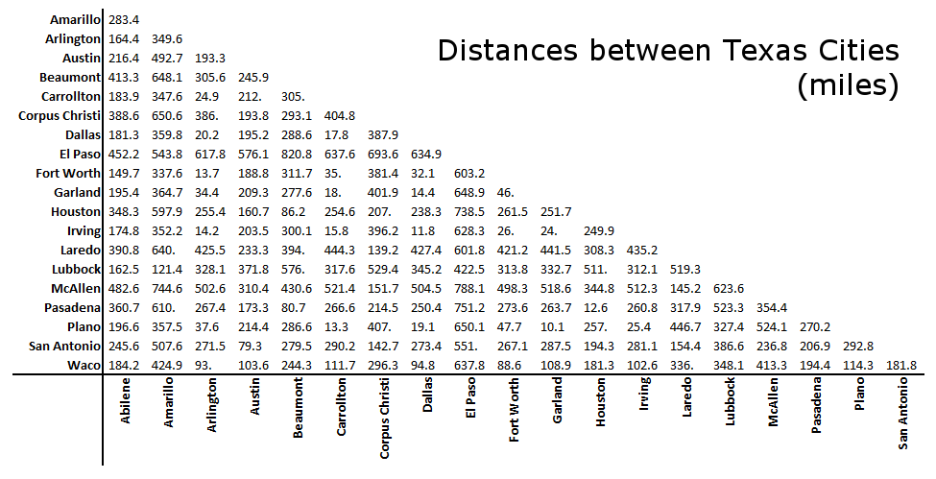
Example application of weighted graph
Travelling salesperson problem: "Given a list of cities and the distances between each pair of cities, what is the shortest possible route that visits each city and returns to the origin city?"
source
Notes:
https://www.ultra-mileage.com/tools.php
https://www.datacamp.com/community/tutorials/networkx-python-graph-tutorial

Slide 54
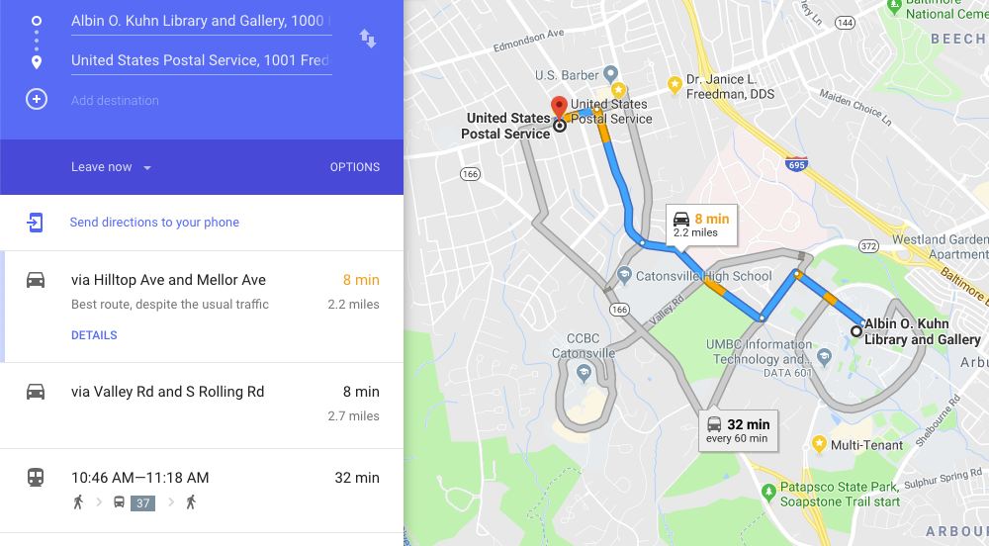
https://blogs.cornell.edu/info2040/2011/09/14/google-maps-its-just-one-big-graph/
https://motherboard.vice.com/en_us/article/4x3pp9/the-simple-elegant-algorithm-that-makes-google-maps-possible
Notes:
https://www.avglab.com/andrew/PDF/hd-jour.pdf
https://www.avglab.com/andrew/PDF/hi-dim.pdf

Slide 55
weighted graph and adjacency matrix
A
H
 | A | B | C | D | E | F | G | H | J | K | M
A | 0 | 4 | 0 | 0 | 0 | 0 | 0 | 0 | 0 | 0 | 0
B | 4 | 0 | 0 | 0 | 0 | 0 | 0 | 0 | 0 | 0 | 0
C | 0 | 0 | 0 | 0 | 4 | 0 | 2 | 0 | 0 | 0 | 0
D | 0 | 0 | 0 | 0 | 0 | 0 | 0 | 2 | 0 | 0 | 0
E | 0 | 0 | 4 | 0 | 0 | 0 | 0 | 0 | 0 | 4 | 0
F | 0 | 0 | 0 | 0 | 0 | 0 | 0 | 0 | 0 | 0 | 1
G | 0 | 0 | 2 | 0 | 0 | 0 | 0 | 4 | 0 | 4 | 0
H | 0 | 0 | 0 | 2 | 0 | 0 | 4 | 0 | 0 | 0 | 0
J | 0 | 0 | 0 | 0 | 0 | 0 | 0 | 0 | 0 | 1 | 0
K | 0 | 0 | 0 | 0 | 4 | 0 | 4 | 0 | 1 | 0 | 0
M | 0 | 0 | 0 | 0 | 0 | 1 | 0 | 0 | 0 | 0 | 0
J
B
G
C
K
F
D
E
M

Slide 56
Directed weighted graph and adjacency matrix
A
H
 | A | B | C | D | E | F | G | H | J | K | M
A | 0 | 4 | 0 | 0 | 0 | 0 | 0 | 0 | 0 | 0 | 0
B | 4 | 0 | 0 | 0 | 0 | 0 | 0 | 0 | 0 | 0 | 0
C | 0 | 0 | 0 | 0 | 4 | 0 | 2 | 0 | 0 | 0 | 0
D | 0 | 0 | 0 | 0 | 0 | 0 | 0 | 2 | 0 | 0 | 0
E | 0 | 0 | 4 | 0 | 0 | 0 | 0 | 0 | 0 | 4 | 0
F | 0 | 0 | 0 | 0 | 0 | 0 | 0 | 0 | 0 | 0 | 1
G | 0 | 0 | 2 | 0 | 0 | 0 | 0 | 4 | 0 | 4 | 0
H | 0 | 0 | 0 | 2 | 0 | 0 | 4 | 0 | 0 | 0 | 0
J | 0 | 0 | 0 | 0 | 0 | 0 | 0 | 0 | 0 | 1 | 0
K | 0 | 0 | 0 | 0 | 4 | 0 | 4 | 0 | 1 | 0 | 0
M | 0 | 0 | 0 | 0 | 0 | 1 | 0 | 0 | 0 | 0 | 0
J
B
G
C
K
F
D
E
M

Slide 57
Example application of Weighted directed graphs
Social interactions, e.g., dating
Cooking: 0.2
Sports: 0.2
Sports: 0.1
Cars: 0.3
Sports: 0.4
Direction: interested in
Weight:
shared interests
distance
Notes:
https://globaldatinginsights.com/2015/08/18/18082015-how-dating-sites-match-singles-up-using-advanced-graphs/
https://linkurio.us/blog/recommendation-and-graphs-an-online-dating-use-case/

Slide 58
Vote for the missing entry in the table

Slide 59
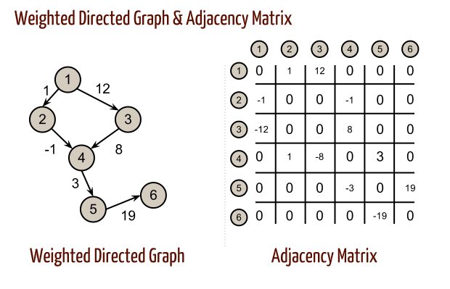

Slide 60
No direct
connection between 2 and 5

Slide 61
Standard problems when using graphs
Fully connected graph has little value
Visualization may not add value
Visualization can be computationally expensive for large graphs
Visualization can be slow to render for large graphs

Slide 62
Graph software
https://cytoscape.org/

Slide 63
Data sources
https://networkdata.ics.uci.edu/

Slide 64
Activity: graph data analysis
Computer network data from https://csr.lanl.gov/data/2017.html
This qualifies as "big data" -- 6 to 7 GB per day (100M rows)
Work in pairs to determine how much data (number of rows) can be visualized using networkx
How does node and edge labeling matter to scale of visualization?

Slide 65

Ethics and Legality

Slide 66
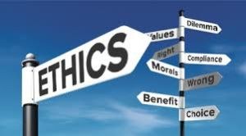
Ethics and Legality
These notes are CC BY 4.0
I'm not going to tell you what to think
I'm not going to tell you how to think
I'm going to recommend some points to ponder
https://medium.com/doteveryone/oaths-pledges-and-manifestos-a-master-list-of-ethical-tech-values-26e2672e161c
Notes:
https://www.sciencelearn.org.nz/resources/2150-teaching-ethics

Slide 67
Outcome of pondering ethical/moral issues
express your own values
explore, with empathy, the values of other people
critically analyze values and actions based on them
discuss disagreements that arise from differences in values and negotiate solutions
make ethical decisions and act on them.
source

Slide 68

Activity: how you respond to disagreement
Write down how you respond when you see an ethical problem,
either with a process, a person's motives, or with a person's actions
What is your initial emotional response?
What is your initial intellectual response?
When do you engage and when do you defer?
Instructor will not be collecting these notes
You won't be sharing these observations with other students

Slide 69

DATA 605: Ethical and Legal Issues in Data Science

Slide 70
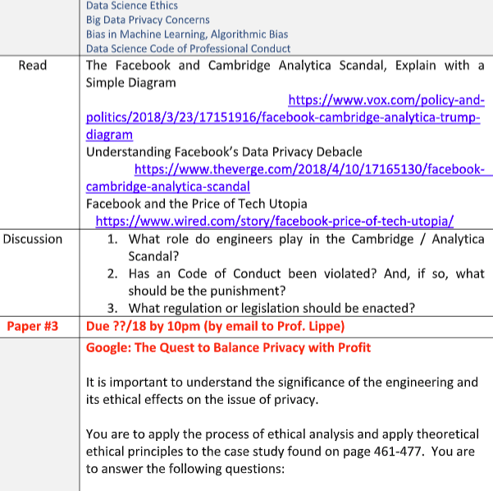
In the "Management Science Pathway", a related course: ENMG 656
Data Science dept has coordinated with the instructor of Engineering Law and Ethics
to include applications to Data Science
Reading for ENMG 656:
Google: Quest to balance Privacy with Profit
Notes:
Based on http://engm.umbc.edu/courses.php there are some useful non-technical aspects covered which Data Science students will benefit from.

Slide 71
Relevance of Ethics to Data
In 2017 the National Science Foundation awarded $484,888 to investigate "using Big Data technology responsibly -- in accordance with ethical and moral norms, and legal and policy considerations."
https://www.nsf.gov/awardsearch/showAward?AWD_ID=1741047

Slide 72
Major Take-aways
Major Take-aways
Ethics of Data
Ethics in Data Science

Slide 73
Major Take-away: pre-cache responses
If you have not considered an approach for a situation, you will need to think of a response in real time.
Due to situational stresses, your response may be suboptimal

Slide 74
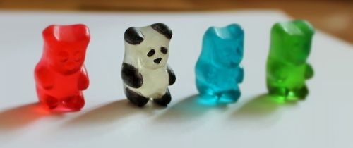
Major Take-away: consistency of approaches
In a large organization or community, not everyone will share your moral/ethical/legal constraints
Enforcing conformity is costly:
Awareness of policies
Enforcement mechanisms
Cost of violating conventions

Slide 75
Major Take-away: you safeguard privacy
Given your skillset, you will likely have access to data
You may be responsible for setting policy

Slide 76

"I didn't know that was illegal"
Ignorance of the law is no defense to criminal charges
Mistakes happen, but that doesn't mean you're not liable
I am not a lawyer
This is not legal advice
Notes:
https://www.nolo.com/legal-encyclopedia/can-i-convicted-crime-i-didn-t-realize-i-illegal.html
https://www.nolo.com/legal-encyclopedia/is-mistake-fact-defense-criminal-charges.html

Slide 77
Ethics of Data
Major Take-aways
Ethics of Data
Ethics in Data Science

Slide 78
Data sources that may have sensitive information
Advertising
Web clicks
Business analytics
CCTV images
Often the person providing the information doesn't get a choice
You (the data scientist) have a moral (and perhaps legal) responsibility to protect the data

Slide 79
Example: Data access and sharing policies
"Cambridge Analytica harvested the personal data of millions of people's Facebook profiles without their consent and used it for political purposes."
First reported in 2015
https://en.wikipedia.org/wiki/Facebook%E2%80%93Cambridge_Analytica_data_scandal

Slide 80
You may be responsible for a lot of data
Access to employee records, health data, finances, project status
And you combine multiple data sets
And you aggregate the knowledge

Slide 81
Activity: sharing data
Count off by 1,2,3,4,5,6,7,8,1,2,3,4,5,6,7,8
Split class into two halves (first 1 to 8; second 1 to 8)
Review role play prompt
Pair up with the other person who has the same number as you

Slide 82
Analysis of Activity
An action was taken
Two people have different opinions on whether that action was "right"
There exists a fundamental conflict between each person's principles

Slide 83
Responses to potential conflict
Normal responses:
Ignore, hope that it goes away
Ignore, hope that someone else intervenes
Ignore, hope that the consequence doesn’t impact me
Suggested response:
Talk with others to determine how others view the issue
Express (genuine) curiosity towards the person's motives
Explain how your principles are different

Slide 84
Data security
As a data scientist, you normally don't focus on
Encrypted data transfer
Encryption of data at rest
Authenticating access to data
Logging activities
In a small organization, you may be required to help in these areas

Slide 85
Laws on data
Location specific
California Online Privacy Protection Act applies to any person or company whose website, online service, or mobile app collects personal information from California consumers.
Europe’s General Data Protection Regulation (GDPR)
Domain specific:
Health Insurance Portability and Accountability Act of 1996 (HIPAA)
Gramm-Leach-Bliley Act (GLBA) is a federal law that regulates how financial institutions must handle personal information

Slide 86

Anonymize sensitive data
Anonymization is the process of removing personal identifiers, both direct and indirect, that may lead to an individual being identified.
An individual may be directly identified from their name, address, postcode, telephone number, photograph or image, or some other unique personal characteristic.
An individual may be indirectly identifiable when certain information is linked together with other sources of information, including, their place of work, job title, salary, their postcode or even the fact that they have a particular diagnosis or condition.
Source
Notes:
https://en.wikipedia.org/wiki/Data_anonymization
https://piwik.pro/blog/the-ultimate-guide-to-data-anonymization-in-analytics/

Slide 87
Risk of Inference; Deanonymization by Aggregation
Even with anonymized data, it may be possible to identify harmful information
Example: person has either lung cancer or brain cancer
Combining multiple data sources to identify individuals

Slide 88
Massachusetts Group Insurance Commission released "anonymized" data on state employees that showed every single hospital visit.
GIC removed obvious identifiers such as name, address, and Social Security number.
William Weld, then Governor of Massachusetts, assured the public that GIC had protected patient privacy.
Latanya Sweeney knew that Governor Weld resided in Cambridge, Massachusetts, a city of 54,000 residents and seven ZIP codes.
For $20, Sweeney purchased the complete voter rolls from the city of Cambridge, a database containing, among other things, the name, address, ZIP code, birth date, and sex of every voter.
By combining this data with the GIC records, Sweeney found Governor Weld with ease. Only six people in Cambridge shared his birth date, only three of them men, and of them, only he lived in his ZIP code.
Sweeney sent the Governor’s health records (which included diagnoses and prescriptions) to his office.
Notes:
https://arstechnica.com/tech-policy/2009/09/your-secrets-live-online-in-databases-of-ruin/
https://news.ycombinator.com/item?id=2942967
https://dataprivacylab.org/projects/identifiability/
https://dataprivacylab.org/projects/identifiability/paper1.pdf

Slide 89
Buying and selling data
Ethics of hospital/insurance selling medical data
You will likely be buying data, selling data, or both

Slide 90
Ethics and Morals of Data Science
Major Take-aways
Ethics of Data
Ethics in Data Science

Slide 91
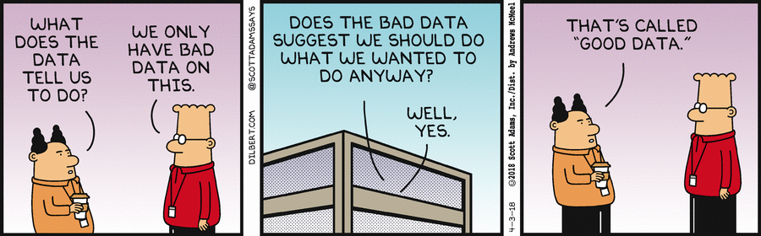
Validating Expectations
Notes:
This is depressingly common.
How will you, the morally righteous ethical data scientist respond?

Slide 92
Undesired outcome of predictions
https://www.linkedin.com/pulse/20140616204813-2554671-lessons-from-target-s-pregnancy-prediction-pr-fiasco/
Notes:
This slide needs more than just a link

Slide 93
Misleading investors
AI is actually mechanical turk
https://news.ycombinator.com/item?id=18043969
Notes:
This slide needs more than just a link

Slide 94
Activity: discuss with partner
Count off by 1,2,3,4,5,6,7,8,1,2,3,4,5,6,7,8
Write down your responses to the following questions:
How do you collaborate with coworkers who underperform?
How do you collaborate with coworkers who have divergent goals?
How do you compete with people who operate with fewer moral constraints (cheaters)? Different moral frameworks enable alternative actions.

Slide 95
Collect Responses on white board

Slide 96
Responses
Under performing coworker:
Escalate to boss
Work as a team – seek collaboration
Evaluate as a group – provide clear expectations
Fire them
Is this one time or recurring?
Offer the coworker training
Seek an explanation for the behavior
Divergent goals:
Seek context and reasoning
Identify shared goals
Is the divergence stylistic?
Find something in common (even if the commonality is outside the goal)

Slide 97
Homework
Addressing points from previous week
Introduction to Graphs
Directed Graphs
Weighted Graphs
Ethics
Homework

Slide 98
Homework: Elevator pitch
Addressing points from previous week
Introduction to Graphs
Directed Graphs
Weighted Graphs
Homework
Elevator pitch

Slide 99
How I use short exposure to leaders
Where: hallway encounters
Leader's exposure to low-level truth is limited
[Good] leaders don't want to micromanage
What does leadership expect to hear?
Not enough resources (people, money, time, computers, data)
Everything is going great
I will get that report to you by Thursday

Slide 100
How I use short exposure to leaders
Can I describe something novel?
What are you planning to do next?
Rumors need to be vetted before sharing
Duplicative efforts with other teams
No one likes delivering bad news
(Project) is going to be late
(Project) is unlikely to succeed
--> This is the ground truth leaders want
Mid-level managers dislike delivering bad news to leaders

Slide 101
Activity: elevator pitch
Step 1 of 3
Check blackboard for your randomly selected group of 3.

Slide 102
Homework: elevator pitch
Step 1 of 3
Check blackboard for assignment.

Slide 103
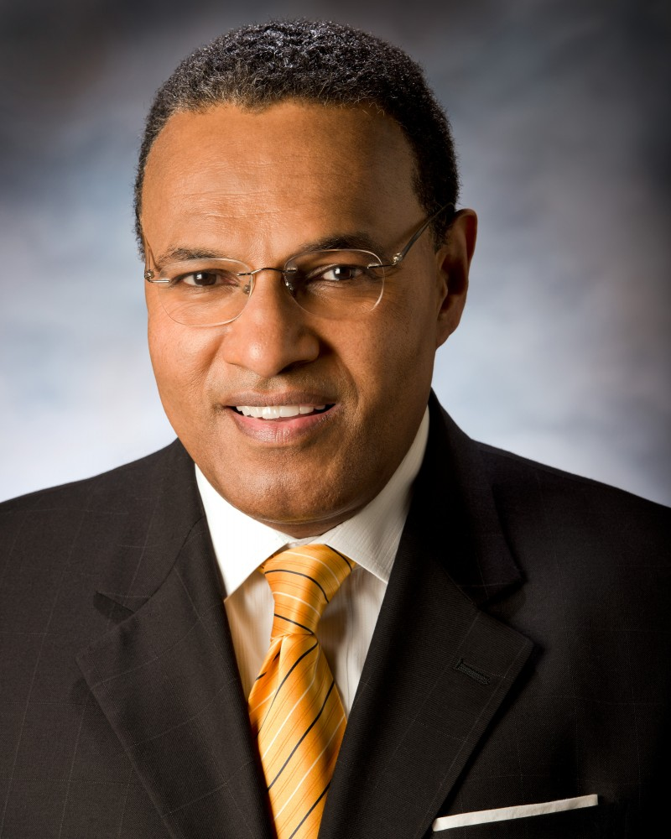
Homework: develop an elevator pitch
Step 2 of 3
Situation: You see Freeman Hrabowski
(President of UMBC) walking towards
the UMBC library.
Explain what you are learning about
data science and what you plan to use
your skills for

Slide 104

Homework: upload your elevator to Blackboard
Step 3 of 3

Slide 105
Activity: Know/Don't know/Want to know
On a paper that you will turn email to John prior to departing, write down
1 thing you already knew that was covered in this session
1 thing covered in this session you didn't previously know
1 thing you wanted to know but wasn't covered in this session

Slide 106
Reading assignment --> Quiz on Blackboard
"Mining massive datasets"
page 163 to 168 (181 to 186 in the PDF)
plus the summary of chapter 5 on page 196-197 (214 to 215)

Slide 107
Homework assignment: parse .ipynb files
Create a notebook that finds all other notebooks used for Data 601 on your computer and generates a list of the modules used
Lines of code that start with either "from" or "import"
Your notebook should analyze at least 8 notebooks
Submit your python notebook (.ipynb file) containing the code for the implementation and the results. Results are a list of modules used.
Optional bonus question: How many lines of Python code have you created for Data 601?

Slide 108
Breakdown the Homework, Part 1 of 2
Draw or write down what you're starting with
Draw or write down what the outcome should look like

Slide 109
Breakdown the Homework, Part 2 of 2: Design your approach to solving the problem
Given the starting point and end point, what steps are needed?
Write down actions you'll need to take
Determine the dependencies among the actions you need to take
In what order should the steps be?
If you have time before leaving, take the listed actions using your computer

Slide 111
Log data
https://www.loganalyzer.net/log-analysis-tutorial/log-file-sample-explain.html
https://www.jafsoft.com/searchengines/log_sample.html
https://www.blendo.co/blog/clickstream-data-mining-techniques-introduction/
http://www.herongyang.com/Windows/Web-Log-File-IIS-Apache-Sample.html
https://dataplatform.cloud.ibm.com/docs/content/wsj/streaming-pipelines/clickstream_example_pipeline.html

Slide 112
Wikipedia clickstream
https://old.datahub.io/dataset/wikipedia-clickstream
https://en.wikipedia.org/wiki/Click_path
https://ewulczyn.github.io/Wikipedia_Clickstream_Getting_Started/
https://wikimediafoundation.org/news/2018/01/16/wikipedia-rabbit-hole-clickstream/
https://wikimediafoundation.org/news/2018/01/16/wikipedia-rabbit-hole-clickstream/
http://databricks-michael.s3.amazonaws.com/Wikipedia%20Clickstream%20Data.html

